Slide 1
AI Agent Integrations

Slide 2
My role:
“Agent communication & MCP Architecture”
To put it simply, I will be defining how AI agents safely talk to lightning nodes

Slide 3
Problem
Lightining nodes control real money
LLMs cannot call RPC directly
We need a safe, structured interface

Slide 4
MCP vs A2A
MCP = agent ↔ tools / environment
A2A = agent ↔ agent coordination
Decision: MCP is required, A2A optional

Slide 5
Why mcp instead of a2a
Model Context Protocol
Designed for agent ↔ tools / environment interaction
Ideal for exposing Lightning node RPCs (payments, channels, fees) as structured tools
Enforces clear input/output schemas, reducing ambiguity and hallucinations
Enables validation and policy enforcement before executing financial actions
Supports auditability and logging, critical for systems handling real money
Matches the SoK reference architecture for blockchain AI agents
Agent to Agent
Designed for agent ↔ agent coordination and negotiation
Useful when multiple autonomous agents collaborate or compete
Requires agent discovery, identity, and trust assumptions
Adds architectural complexity not needed for a single-agent Lightning controller

Slide 6
Why mcp instead of a2a
Our system currently uses one primary AI agent controlling a Lightning node
Lightning nodes are treated as tools, not agents
MCP provides the simplest, safest, and most academically aligned interface
A2A is deferred as future work for multi-agent Lightning experiments

Slide 7
MCP tool examples
In our system, the Model Context Protocol (MCP) exposes Lightning Network functionality to the AI agent as a set of structured tools with clearly defined permissions. Read-only tools such as get_balance, list_channels, and decode_invoice allow the agent to safely observe wallet state, channel liquidity, and invoice parameters without modifying network state. Write-capable tools, including send_payment, open_channel, and set_channel_fee, enable the agent to perform financial or network-altering actions and therefore require strict validation and policy enforcement. All write operations must pass through a validator and policy engine to enforce constraints such as fee limits, spending caps, channel size restrictions, and human-in-the-loop confirmation when necessary. This separation of read versus write tools ensures that the agent can reason effectively while preventing unsafe or unauthorized Lightning operations, aligning with the SoK architecture’s security and accountability requirements.
get_balance
list_channels
decode_invoice
send_payment
open_channel
set_channel_fee
Highlights:
read vs write
validation required

Slide 8
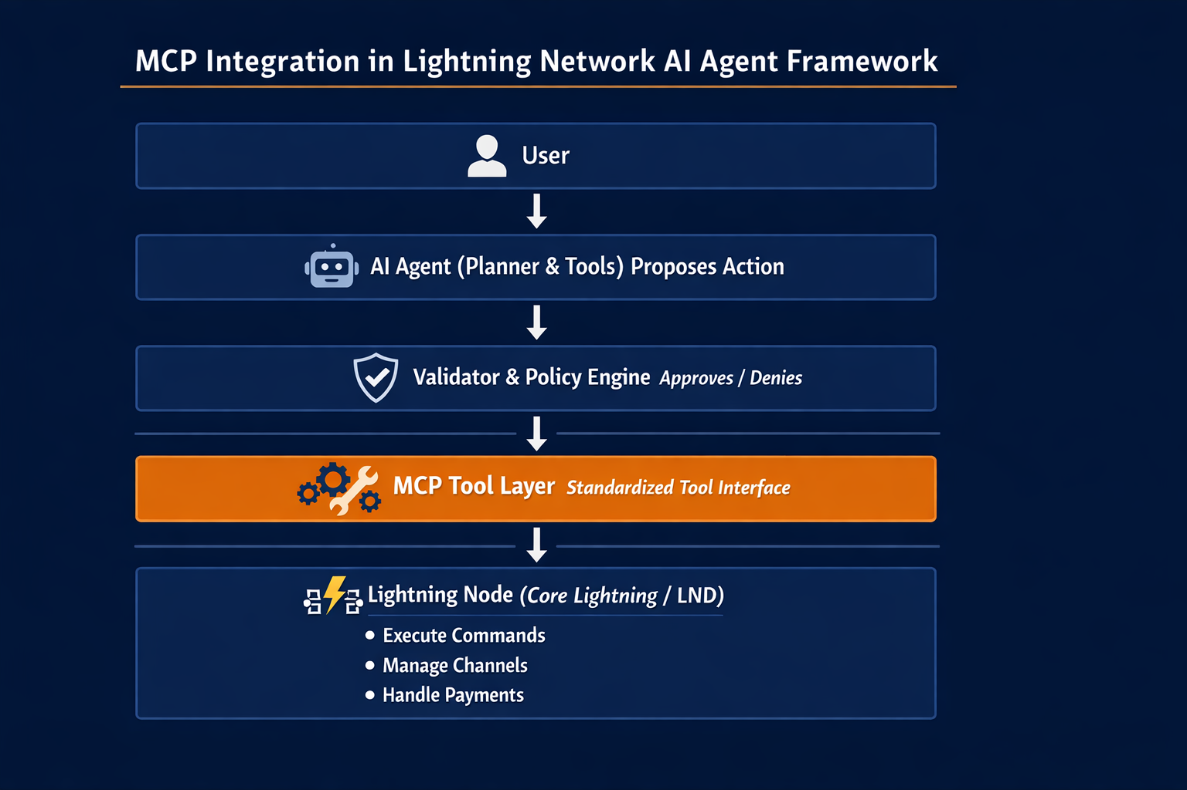
Where MCP fits in our system

Slide 9
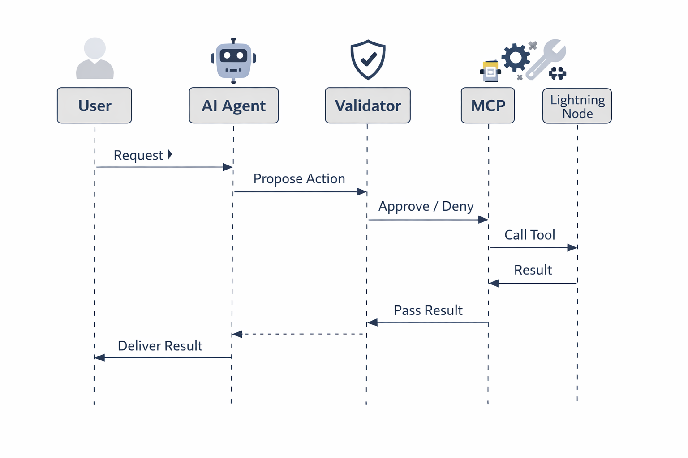
Sequence diagram

